Slide 1
Lecture 9 Sorting

Slide 2
Outline
Introduction and Notation
Insertion Sort
Selection Sort
Shell Sort
Bucket Sort
Radix Sort
-----------------
Divide-and-Conquer Sorting
Mergesort
Quicksort

Slide 3
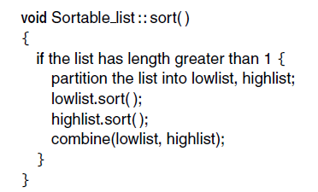
Divide and Conquer Sorting
The main ideas:
It’s easier to sort short lists;
So we can divide the list into sublists and sort the sublists;
Then we combine the sorted sublists into a sorted list;
How to sort the sublists? One way is to use the same method. This process will terminate because a list of one entry is sorted.
Question: How to divide a
list into two sublists and
then combine sorted lists?

Slide 4
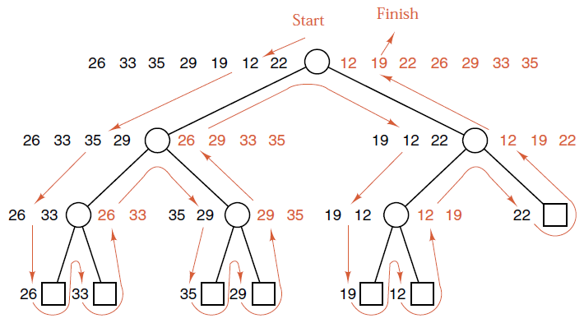
Mergesort
It was invented by John von Neumann in 1945.
Implementation
If the size of the list is greater than 1, chop(拆分) the list into two sublists of equal sizes.
Sort two sublists separately.
Merge the two sorted sublists into a single sorted list.

Slide 5
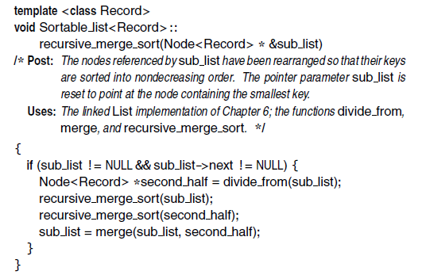
Mergesort for Linked Lists

Slide 6
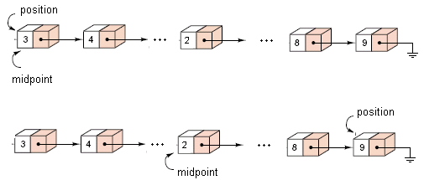
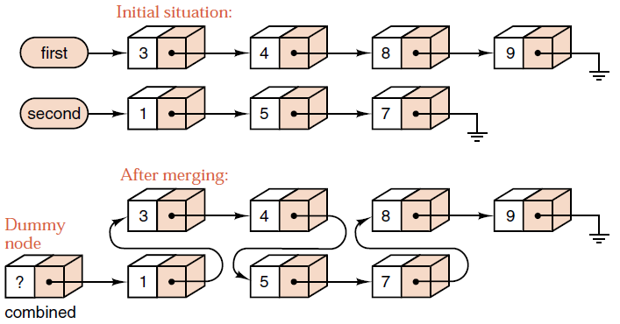
Mergesort for Linked Lists
Divide:
Pointer to the second half
Merge:
头结点

Slide 7
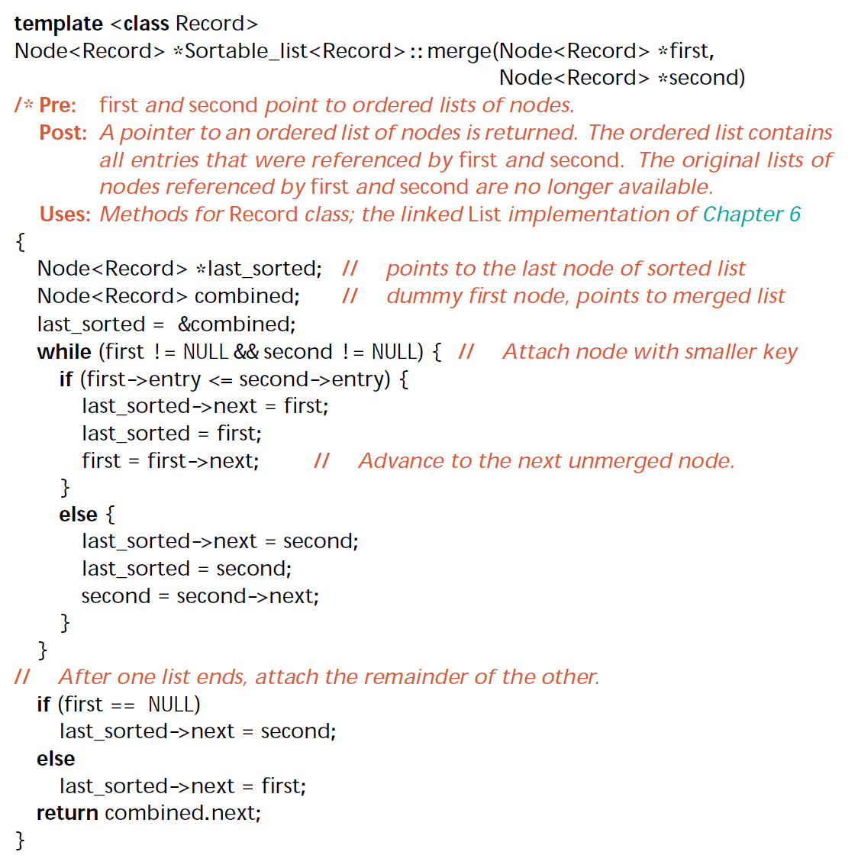
Merge Two Sorted Linked Lists

Slide 8
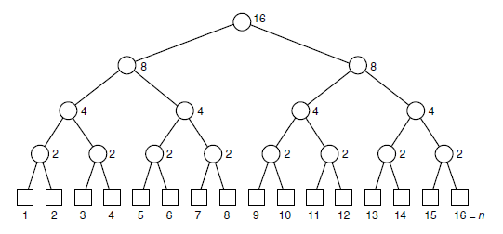
Analysis of Mergesort
On each level, the number of entries to be merged is n;
The number of comparisons on each level except the level on leaves is at most n;
The height of the recursion tree is ⎡lgn⎤, so the total number of comparisons is less than ⎡n lgn⎤.
Notes:
Note: k-way Merge

Slide 9
Analysis of Mergesort
Number of comparisons(average): nlgn-1.1583n+1
Time complexity: O(n logn) for both average-case and worst-case
Space complexity: O(n), or O(1) for in-place mergesort
Stability: stable

Slide 10
Mergesort Application: Inverse number
逆序对：对于一个包含N个非负整数的数组A[1..n]，如果有i < j，且A[i]>A[j]，则称(i, j)为数组A中的一个逆序对。
例如，数组(3, 1, 4, 5, 2)的逆序对有(3,1), (3,2), (4,2), (5,2)，共4个。
枚举：O(n²). n <= 5000适用
归并排序：
Divide: 把序列等分成两半
Conquer: 统计i和j都在左边或者均在右边的逆序对个数。
Combine: 统计i在左边，但j在右边的逆序对个数。
Q: 如何求出i在左边，而j在右边的逆序对个数呢？
A: 对于右边的每个j，统计左边比它大的元素个数f(j)，则所有f(j)之和就是答案。
Time complexity: O(n logn)

Slide 11
Inverse number
int inverse_num = 0;
void inverse_number(int *A, int x, int y, int* T)
{
if (y-x > 1)
{
int m = x + (y-x) / 2; // divide
int p = x, q = m, i = x;
inverse_number(A, x, m, T); // 递归求解
inverse_number(A, m, y, T); // 递归求解
while (p < m || q < y)
{
if(q >= y || (p < m && A[p] <= A[q]))
T[i++] = A[p++];
else {T[i++] = A[q++]; reverse_num += m-p;}
}
for(i=x; i<y; i++) A[i] = T[i];
}
}

Slide 12
Quicksort
We first choose some key from the list for which, we hope, about half the keys will come before and half after. Call this key the pivot.
Then we partition the items so that all those with keys less than the pivot come in one sublist, and all those with greater keys come in another.
Then we sort the two reduced lists separately, put the sublists together, and the whole list will be in order.

Slide 13
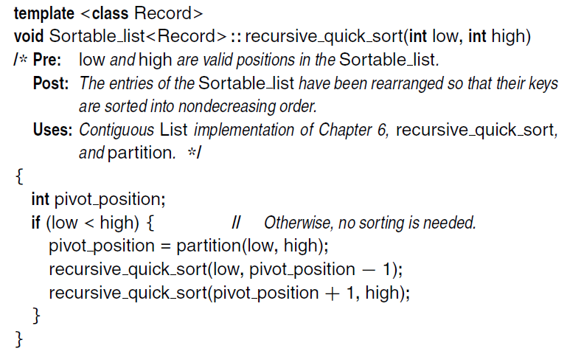
Quicksort for Contiguous Lists
Recursive function:

Slide 14

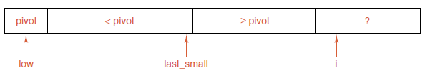
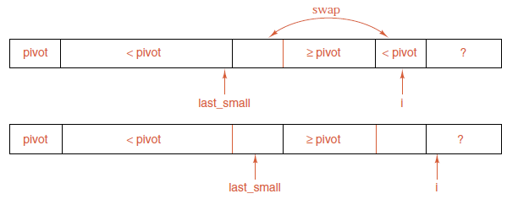

Partitioning the list
Goal:
Loop invariant:
Restore the invariant:
Final position:

Slide 15
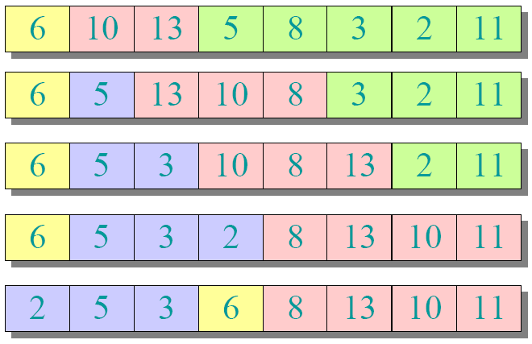
Partitioning Example

Slide 16

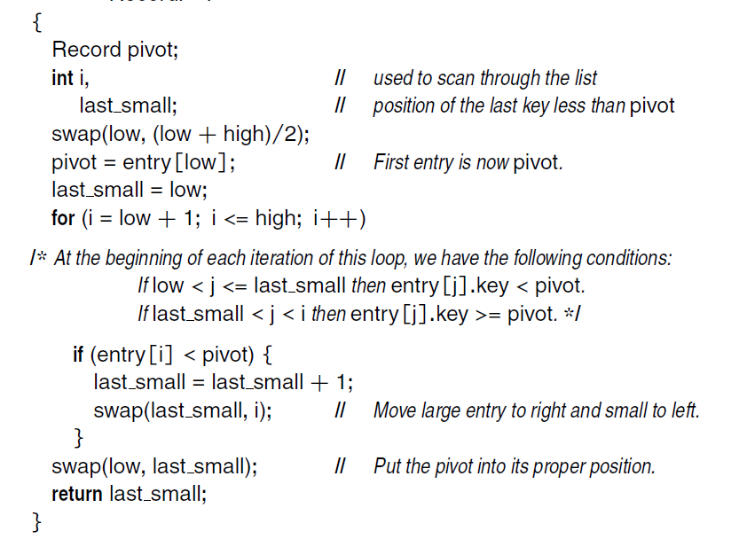
Lomuto’s Partitioning

Slide 17
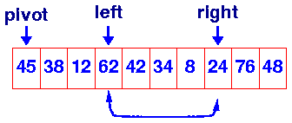
Another Partitioning Implementation
两个指针left和right. left左边的都小于等于x, right右边的都大于x, 未知区域在中间
left和right交替移动, 一旦发现不满足要求的元素就停下来. 交换这两个元素, 使同时满足要求
好处：当相同元素比较多时较快

Slide 18
Hoare’s Partitioning
int partition(int a[], int low, int high )
{
int left, right;
int pivot_item = a[low];
left = low;
right = high;
while ( left < right ) {
/* Move left while item <= pivot */
while( a[left] <= pivot_item && left < high ) left++;
/* Move right while item > pivot */
while( a[right] > pivot_item && low < right ) right--;
if ( left < right ) {
int tmp = a[left];
a[left] = a[right];
a[right] = tmp;
}
}
/* right is final position for the pivot */
a[low] = a[right];
a[right] = pivot_item;
return right;
}

Slide 19
Analysis of Quicksort
Worst-case analysis:
If the pivot is chosen poorly, one of the partitioned sublists may be empty and the other reduced by only one entry. In this case, quicksort is slower than either insertion sort or selection sort.
Choice of pivot:
First or last entry: Worst case appears for a list already sorted or in reverse order.
Central entry: Poor cases appear only for unusual orders.
Random entry: Poor cases are very unlikely to occur.

Slide 20
Analysis of Quicksort
The number of total comparisons:
C(n) = n-1 +C(r) + C(n-r-1)
Let C(n) be the number of comparisons of keys made by quicksort when applied to a list of length n. We have C(1) = C(0) = 0. The partition function compares the pivot with every other key in the list exactly once, and thus the function partition accounts for exactly n − 1 key comparisons, where we assume the list is split into lists of r entries and n - r - 1 entries.
The number of comparisons of the worst case: the worst case is when the pivot cannot split the list into two lists, and one list has n-1 entries, that is, when the list is in increasing order.
C(n) = n-1 + C(n-1)
Solving this recurrence relation: C(n) = ½ n² – ½ n

Slide 21
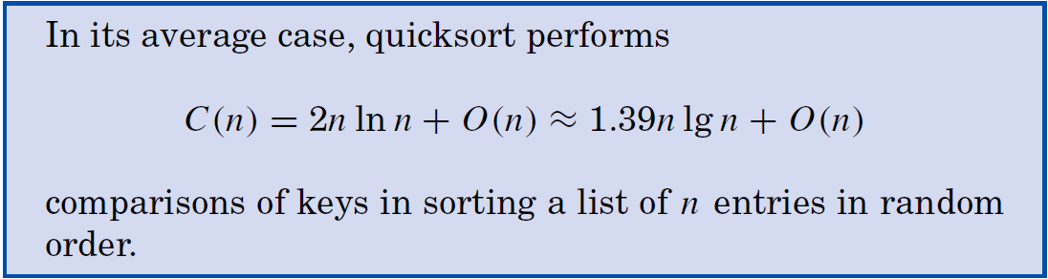
Analysis of Quicksort
To do the average-case analysis, we shall assume that all possible orderings of the list are equally likely, and for simplicity, we take the keys to be just the integers from 1 to n.
If the pivot is the p-th smallest key, let C(n,p) be the average number of key comparisons done.
C(n,p)=n-1+C(p-1)+C(n-p)
Averaging from p = 1 to p = n gives, for n >= 2,
C(n)=n-1+2/n (C(0)+C(1)+…+C(n-1))

Slide 22
Application: Selection Problem
Problem description:
Given array A[1..n], find the k-th smallest element in A
Refer to std::nth_element();

Slide 23
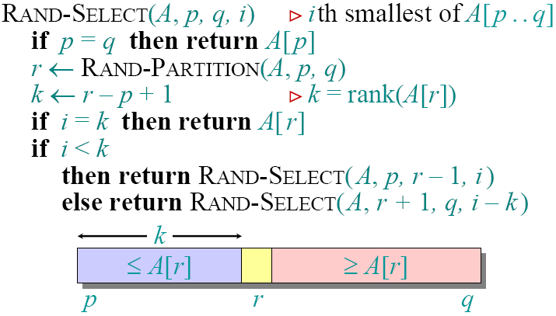
Randomized Selection Algorithm

Slide 24
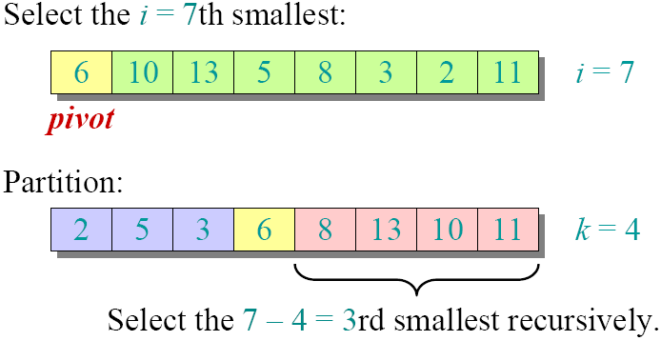
Randomized Selection Algorithm

Slide 25

Analysis of Randomized Selection
Worst case: A[r] = smallest or largest element
Time: T(n) = O(n) (for splitting) + T(n-1)
Solving the recurrence, T(n) = O(n²)
Pr(Worst Case) =
Best case: A[r] is the k-th element
Time taken T(n) = O(n) (for splitting) + O(1)
T(n) = O(n)
Pr(Best Case) >= 1/n

Slide 26
Analysis of Randomized Selection
Average case: Let T(n) be the expected running time on an array of size n
Lucky split: A[r] is the m-th smallest element, for n/4 <= m <= 3n/4. Pr[Lucky Split] = 1/2
T(n) <= Time to split + Pr[Lucky Split] x T(array of size <= 3n/4) + Pr[Unlucky Split] x T(array of size <= n)
<= n + (1/2) T(3n/4) + (1/2) T(n)
Solving, T(n) <= T(3n/4) + 2n = O(n)
Question: Is there a linear selection algorithm for every case?

Slide 27

Thank you!

